Slide 1
MODULE II
DATABASE DESIGN

Slide 2
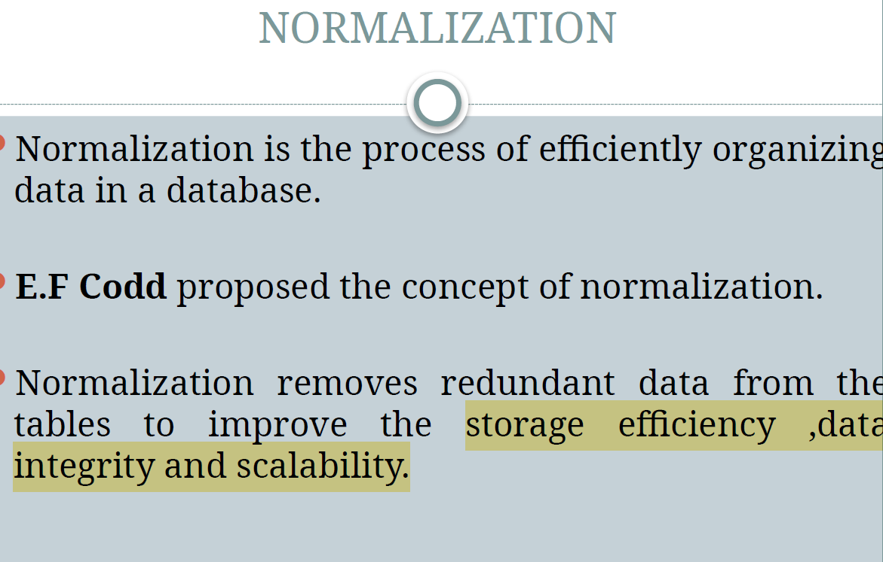

Slide 3
Database normalization is the process of organizing the attributes of the database to reduce or eliminate data redundancy (having the same data but at different places).
Data redundancy unnecessarily increases the size of the database as the same data is repeated in many places. Inconsistency problems also arise during insert, delete, and update operations.
In the relational model, there exist standard methods to quantify how efficient a databases is. These methods are called normal forms and there are algorithms to covert a given database into normal forms.
Normalization generally involves splitting a table into multiple ones which must be linked each time a query is made requiring data from the split tables.

Slide 4
The primary objective for normalizing the relations is to eliminate the below anomalies.
Insertion Anomalies: Insertion anomalies occur when it is not possible to insert data into a database because the required fields are missing or because the data is incomplete. For example, if a database requires that every record has a primary key, but no value is provided for a particular record, it cannot be inserted into the database.
Deletion anomalies: Deletion anomalies occur when deleting a record from a database and can result in the unintentional loss of data. For example, if a database contains information about customers and orders, deleting a customer record may also delete all the orders associated with that customer.
Updation anomalies: Updation anomalies occur when modifying data in a database and can result in inconsistencies or errors. For example, if a database contains information about employees and their salaries, updating an employee’s salary in one record but not in all related records could lead to incorrect calculations and reporting.

Slide 5
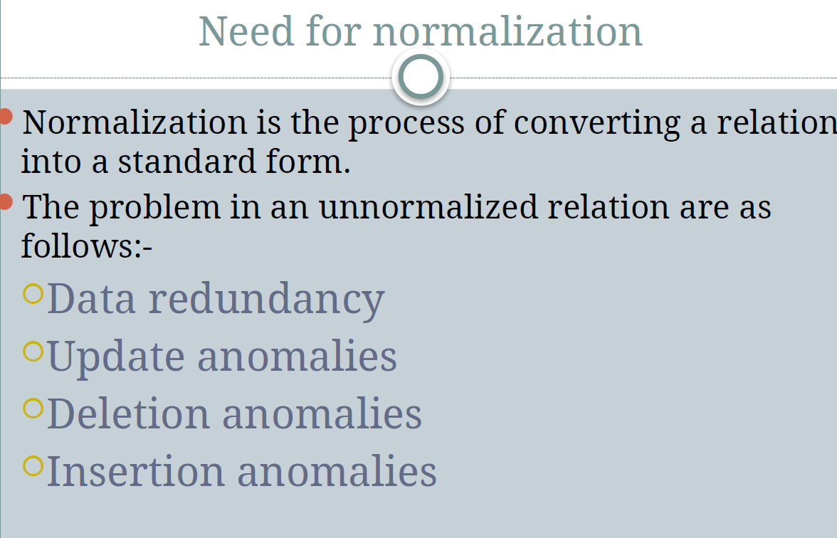

Slide 6
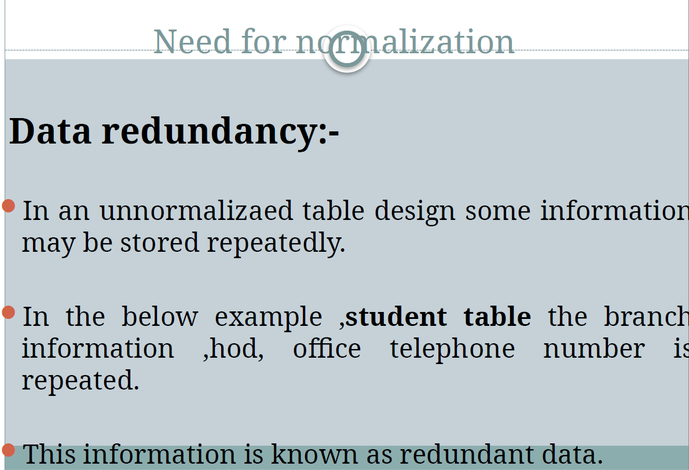

Slide 7
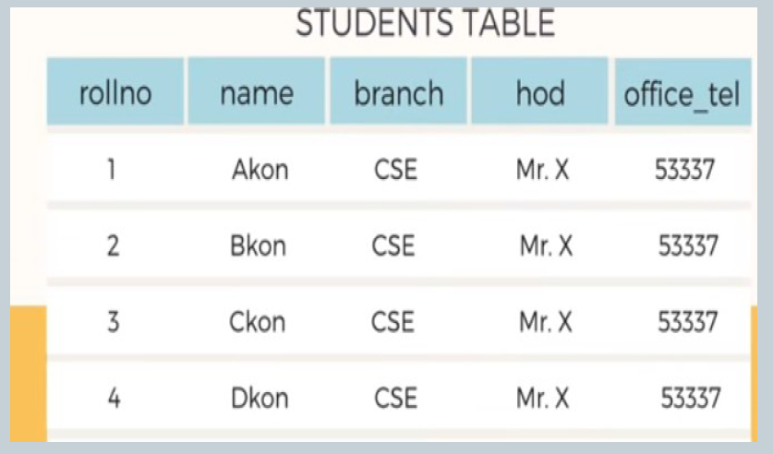

Slide 8
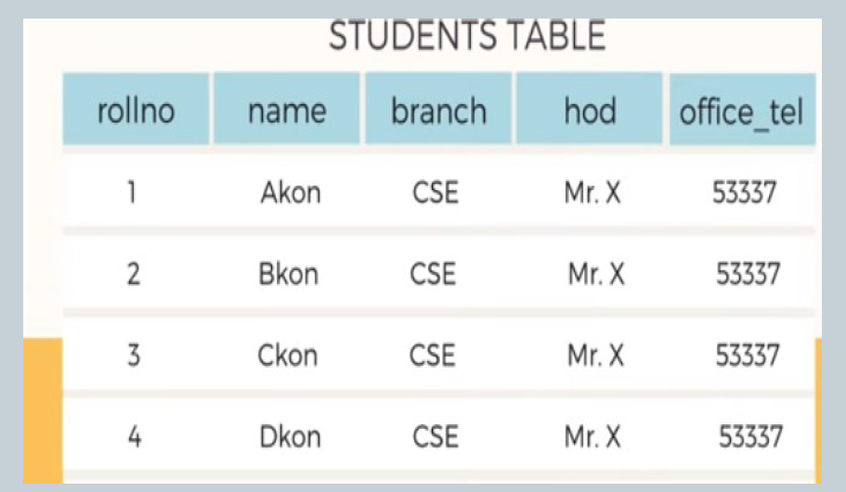
Redundant Data Explanation:
The branch, hod, and office_tel columns have the same values (CSE, Mr. X, 53337) for all students.
This repetition indicates data redundancy because the information about the branch, HOD, and office contact number is stored multiple times.
How to Fix It?
This can be normalized into two tables:
Students Table (rollno, name, branch_id)
Branch Table (branch_id, branch, hod, office_tel)
This structure will avoid redundancy and improve database efficiency.

Slide 9
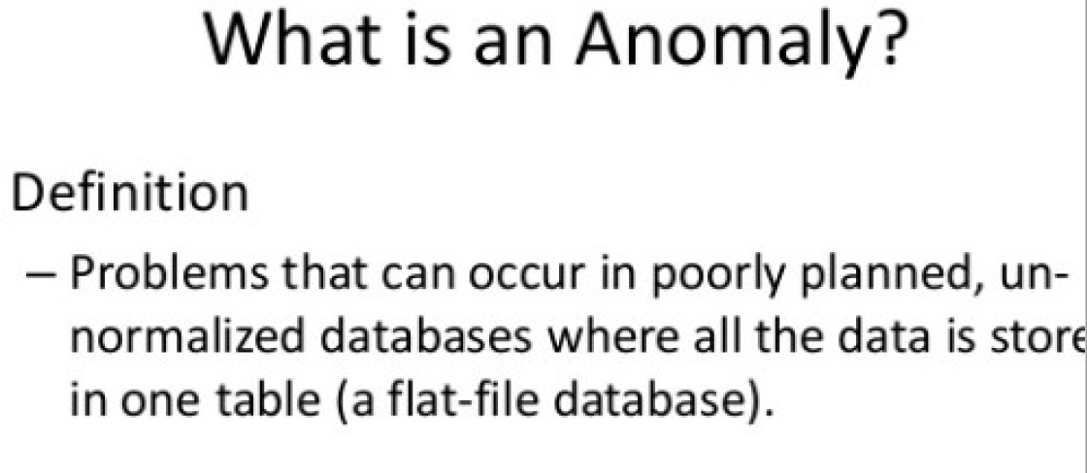

Slide 10
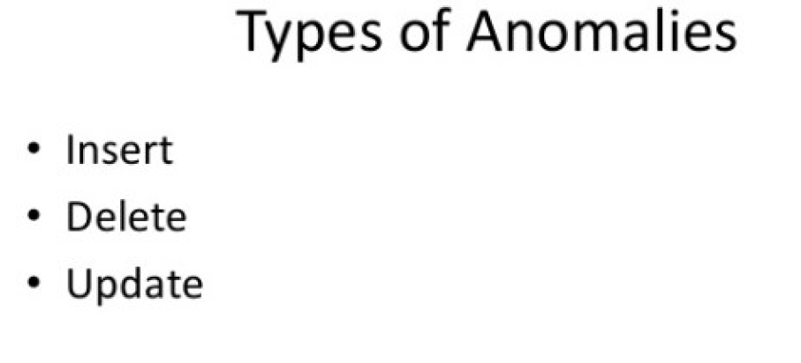

Slide 11
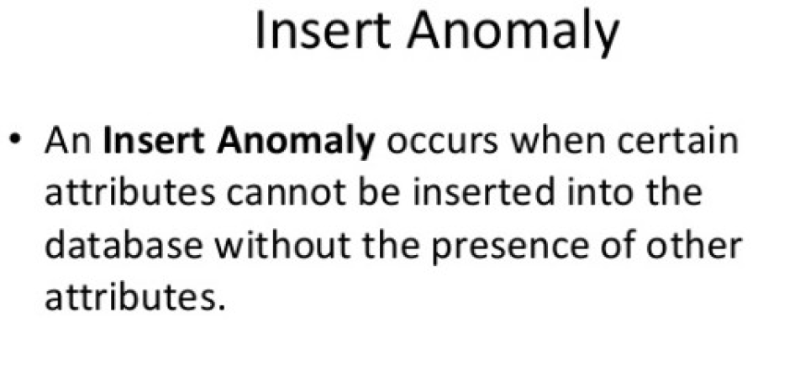

Slide 12
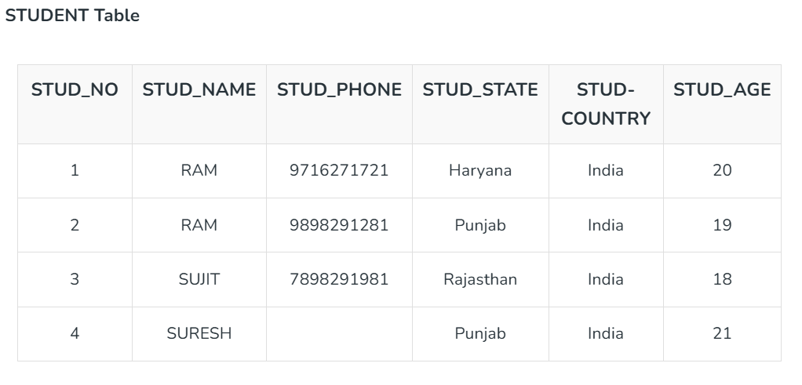

Insertion Anomaly: If a tuple is inserted in referencing relation and referencing attribute value is not present in referenced attribute, it will not allow insertion in referencing relation.
OR
An insertion anomaly occurs when adding a new row to a table leads to inconsistencies.
Example:If we try to insert a record into the STUDENT_COURSE table with STUD_NO = 7, it will not be allowed because there is no corresponding STUD_NO = 7 in the STUDENT table.

Slide 13
Deletion and Updation Anomaly: If a tuple is deleted or updated from referenced relation and the referenced attribute value is used by referencing attribute in referencing relation, it will not allow deleting the tuple from referenced relation.
Example: If we want to update a record from STUDENT_COURSE with STUD_NO =1, We have to update it in both rows of the table.
If we try to delete a record from the STUDENT table with STUD_NO = 1, it will not be allowed because there are corresponding records in the STUDENT_COURSE table referencing STUD_NO = 1.
Deleting the record would violate the foreign key constraint, which ensures data consistency between the two tables.

Slide 14
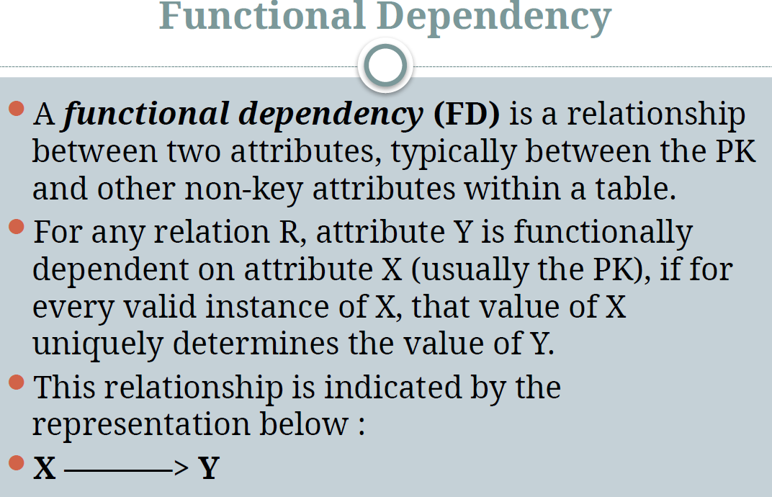

Slide 15
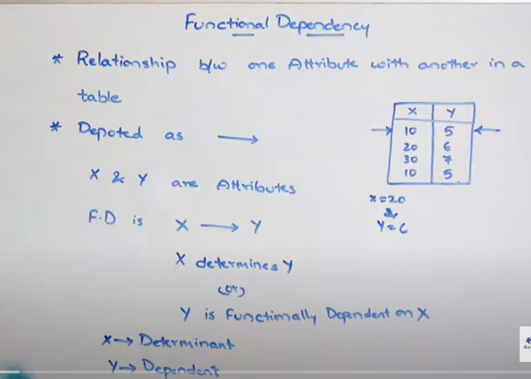

Slide 16
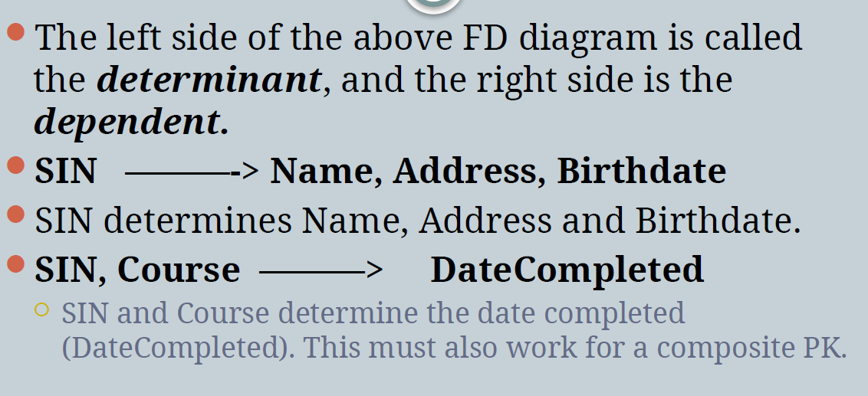

Slide 17
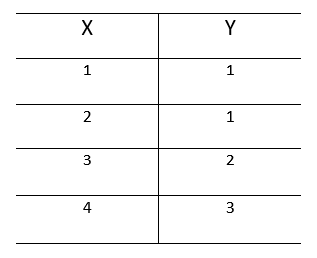
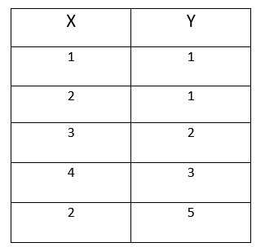
x=2 then y=1
x=2 then y=? (x cannot be determined the y value). In this case we can say there is no functional dependency.That is if X value is same ,Y value also should same.
How to define functional dependency?
FD X -> Y,then
If t1.X = t2.X (if t1.X != t2.X) ,then no need of checking Y value.
Then t1.Y= t2.Y

Slide 18
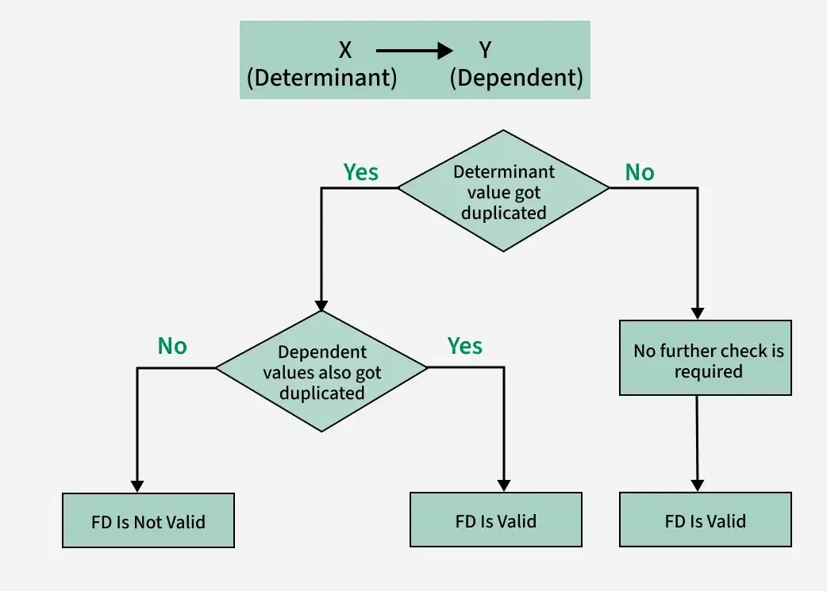

Slide 19
Full Functional Dependency and Partial Functional Dependency
Fully Functional Dependency :
If X and Y are an attribute set of a relation, Y is fully functional dependent on X, if Y is functionally dependent on X but not on any proper subset of X.
Example –
In the relation ABC->D, attribute D is fully functionally dependent on ABC and not on any proper subset of ABC. That means that subsets of ABC like AB, BC, A, B, etc cannot determine D.
Ie, AB->D , not valid
BC-> D, not valid

Slide 20
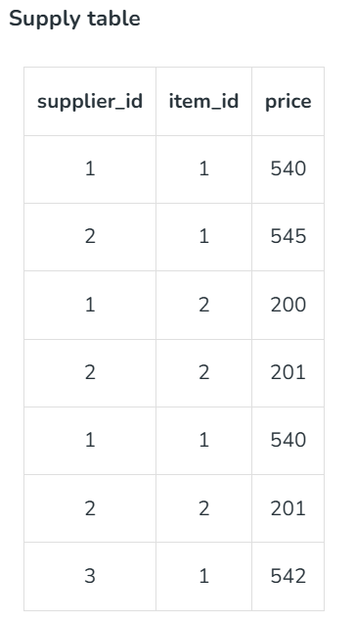
Example
From the table, we can clearly see that neither supplier_id nor item_id can uniquely determine the price but both supplier_id and item_id together can do so. So we can say that price is fully functionally dependent on { supplier_id, item_id }. This summarizes and gives our fully functional dependency −
{ supplier_id , item_id } -> price

Slide 21

Partial Functional Dependency :
A functional dependency X->Y is a partial dependency if Y is functionally dependent on X and Y can be determined by any proper subset of X.
For example, we have a relationship AC->B, A->D, and D->B.
Now if we compute the closure of {A+}=ADB
Here A is alone capable of determining B, which means B is partially dependent on AC.
Let us take another example –
Here, both the attributes name and roll_no alone are able to uniquely identify a course. Hence the relationship is partially dependent.

Slide 22
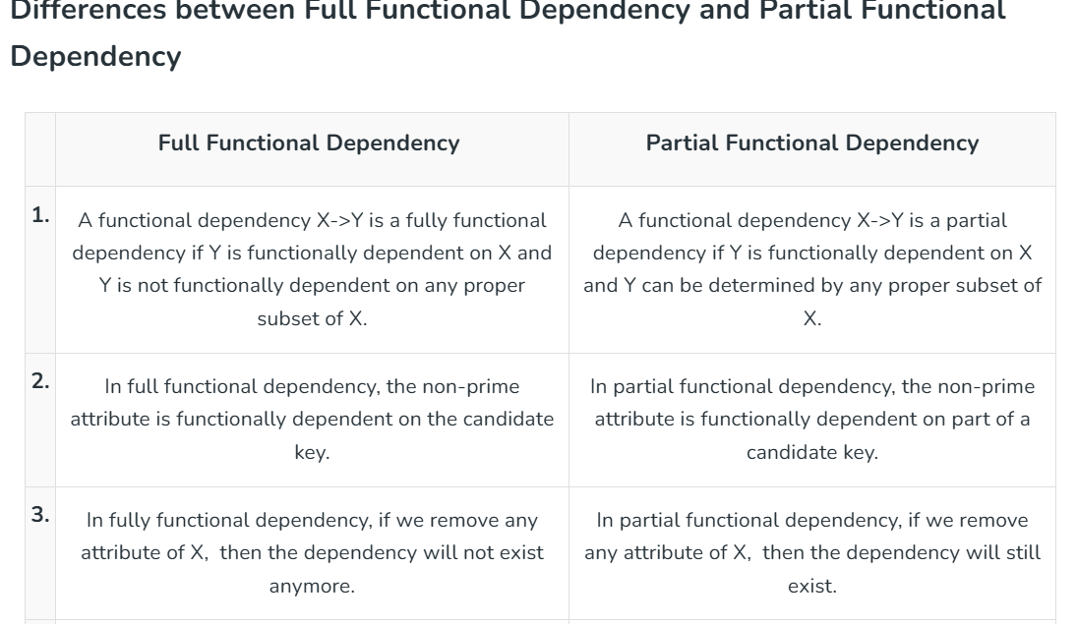

Slide 23
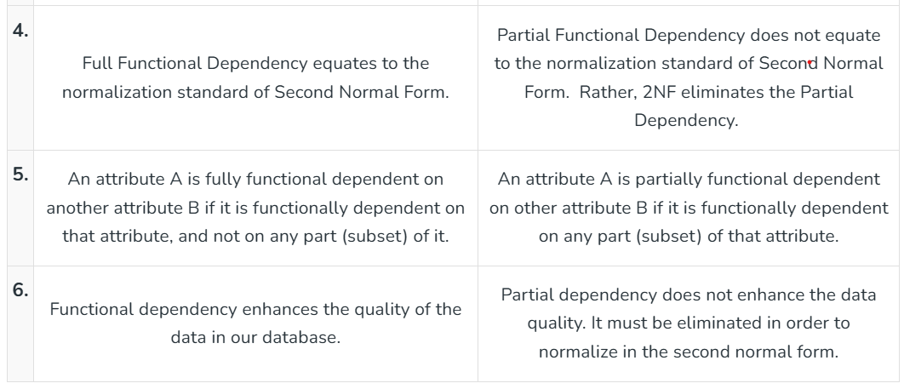

Slide 24
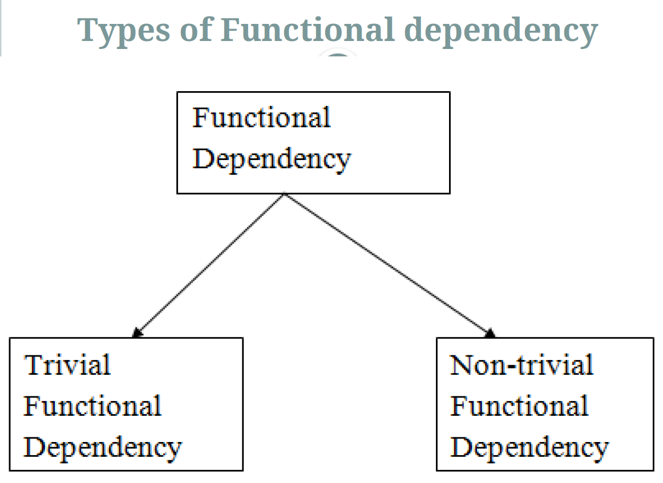

Slide 25
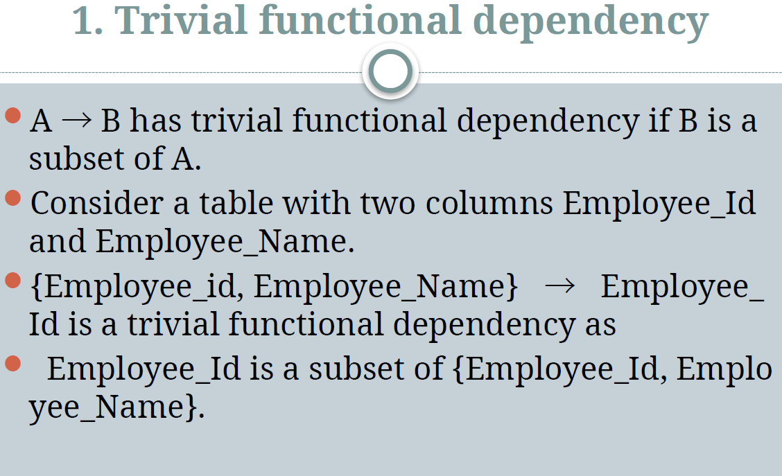

Slide 26
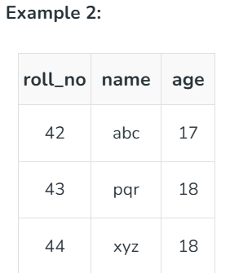
2. Non-trivial functional dependency
In Non-trivial functional dependency, the dependent is strictly not a subset of the determinant. i.e. If X → Y and Y is not a subset of X, then it is called Non-trivial functional dependency.
Example 1 :
Id -> Name
Name -> DOB
Here, roll_no → name is a non-trivial functional dependency, since the dependent name is not a subset of determinant roll_no. Similarly, {roll_no, name} → age is also a non-trivial functional dependency, since age is not a subset of {roll_no, name}

Slide 27
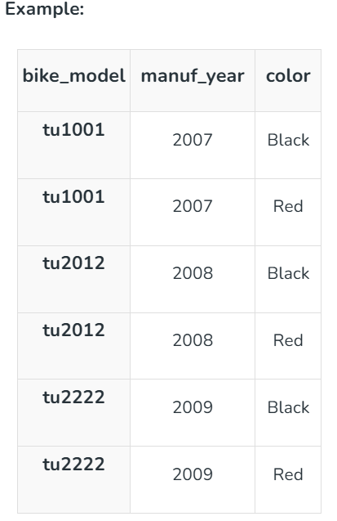
3.Multivalued Functional Dependency
In Multivalued functional dependency, entities of the dependent set are not dependent on each other. i.e. If a → {b, c} and there exists no functional dependency between b and c, then it is called a multivalued functional dependency.

Slide 28
In this table:
X: bike_model
Y: color
Z: manuf_year
For each bike model (bike_model):
There is a group of colors (color) and a group of manufacturing years (manuf_year).
The colors do not depend on the manufacturing year, and the manufacturing year does not depend on the colors. They are independent.
The sets of color and manuf_year are linked only to bike_model.
That’s what makes it a multivalued dependency.
In this case these two columns are said to be multivalued dependent on bike_model.

Slide 29
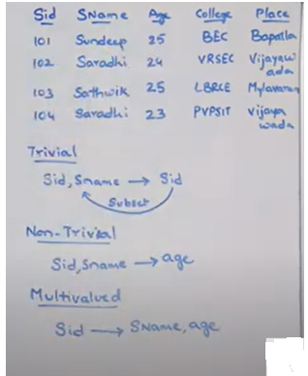

Slide 30
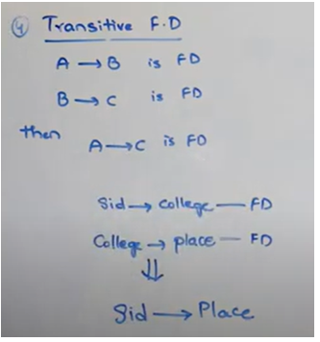
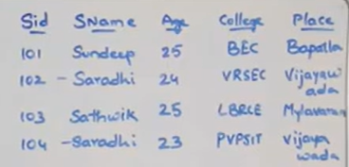
4. Transitive Functional Dependency
In relational databases, transitive dependency occurs when one attribute indirectly depends on another through an intermediate attribute. This problem means that the value of one column can be determined indirectly from the values of two other columns.

Slide 31
Inference Rules(Properties of Functional Dependency)
Inference rules( Properties of Functional Dependency)in databases are also known as Armstrong’s Axioms in Functional Dependency. These rules govern the functional dependencies in a relational database. From inference rules a new functional dependency can be derived using other FDs. These rules were introduced by William W. Armstrong.
Reflexive Rule: According to this rule, if B is a subset of A then A logically determines B. Formally, B ⊆ A then A → B.
Example: Let us take an example of the Address (A) of a house, which contains so many parameters like House no, Street no, City etc. These all are the subsets of A. Thus, address (A) → House no. (B).
Augmentation Rule: It is also known as Partial dependency. According to this rule, If A logically determines B, then adding any extra attribute doesn't change the basic functional dependency.
Example: A → B, then adding any extra attribute let say C will give AC → BC and doesn't make any change.
Transitive rule: Transitive rule states that if A determines B and B determines C, then it can be said that A indirectly determines B.
Example: If A → B and B → C then A → C.

Slide 32
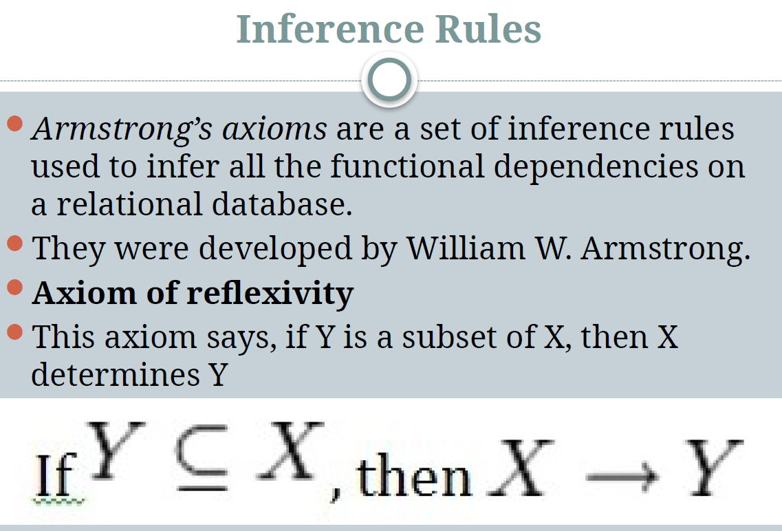

Slide 33
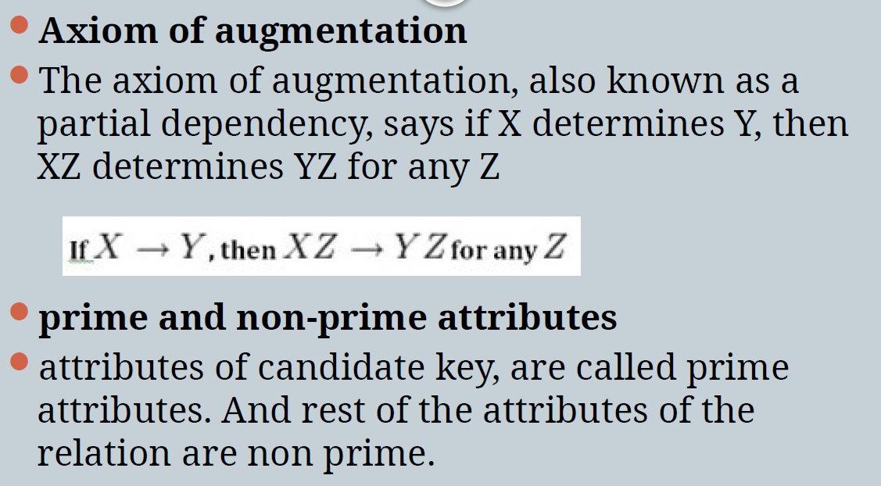

Slide 34
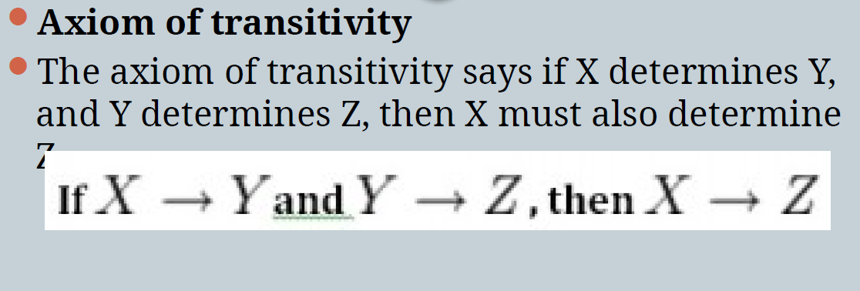

Slide 35
Secondary Rules –
These rules can be derived from the axioms.
Union Rule: Union rule states that If A determines B and C, then A determines BC.
Example: If A → B and A → C then A → BC.
Decomposition Rule: It is perfectly reverse of the above Union rule. According to this rule, If A determined BC then it can be decomposed as A → B and A → C.
Example: If A → BC then A → B and A → C.
Pseudo Transitive Rule: According to this rule, If A determined B and BC determines D then AC determines D.
Example: If A → B and BC → D then AC → D.

Slide 36
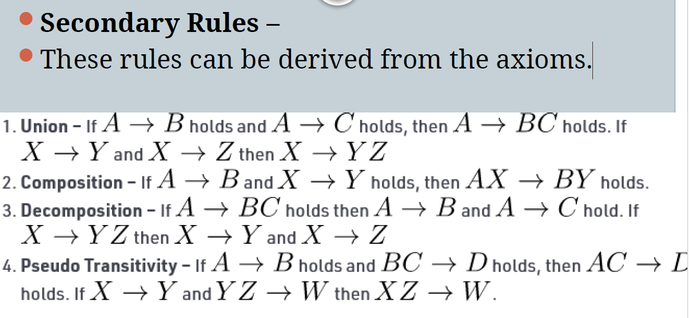

Slide 37
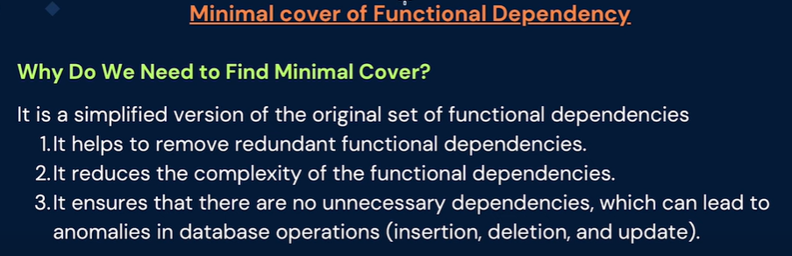
Minimal set of functional dependencies

